Slide 1
XPE The new generation micro service and big-data platform
By Dr Hao He
SoftTouchIT 2017/06/02

Slide 2
Conventional Software Architecture
Component or module based
Functionality is implemented as library
Using functionality is through language specific APIs
Variations on implementation styles:
Procedure styles
Function styles
OO styles
Advantages
Reliable
High performance
Disadvantages
Language specific. Crossing language is difficult.
Platform specific. Crossing platform is very hard.
Very tight coupling. Slight API change can cause great changes throughout the whole systems.

Slide 3
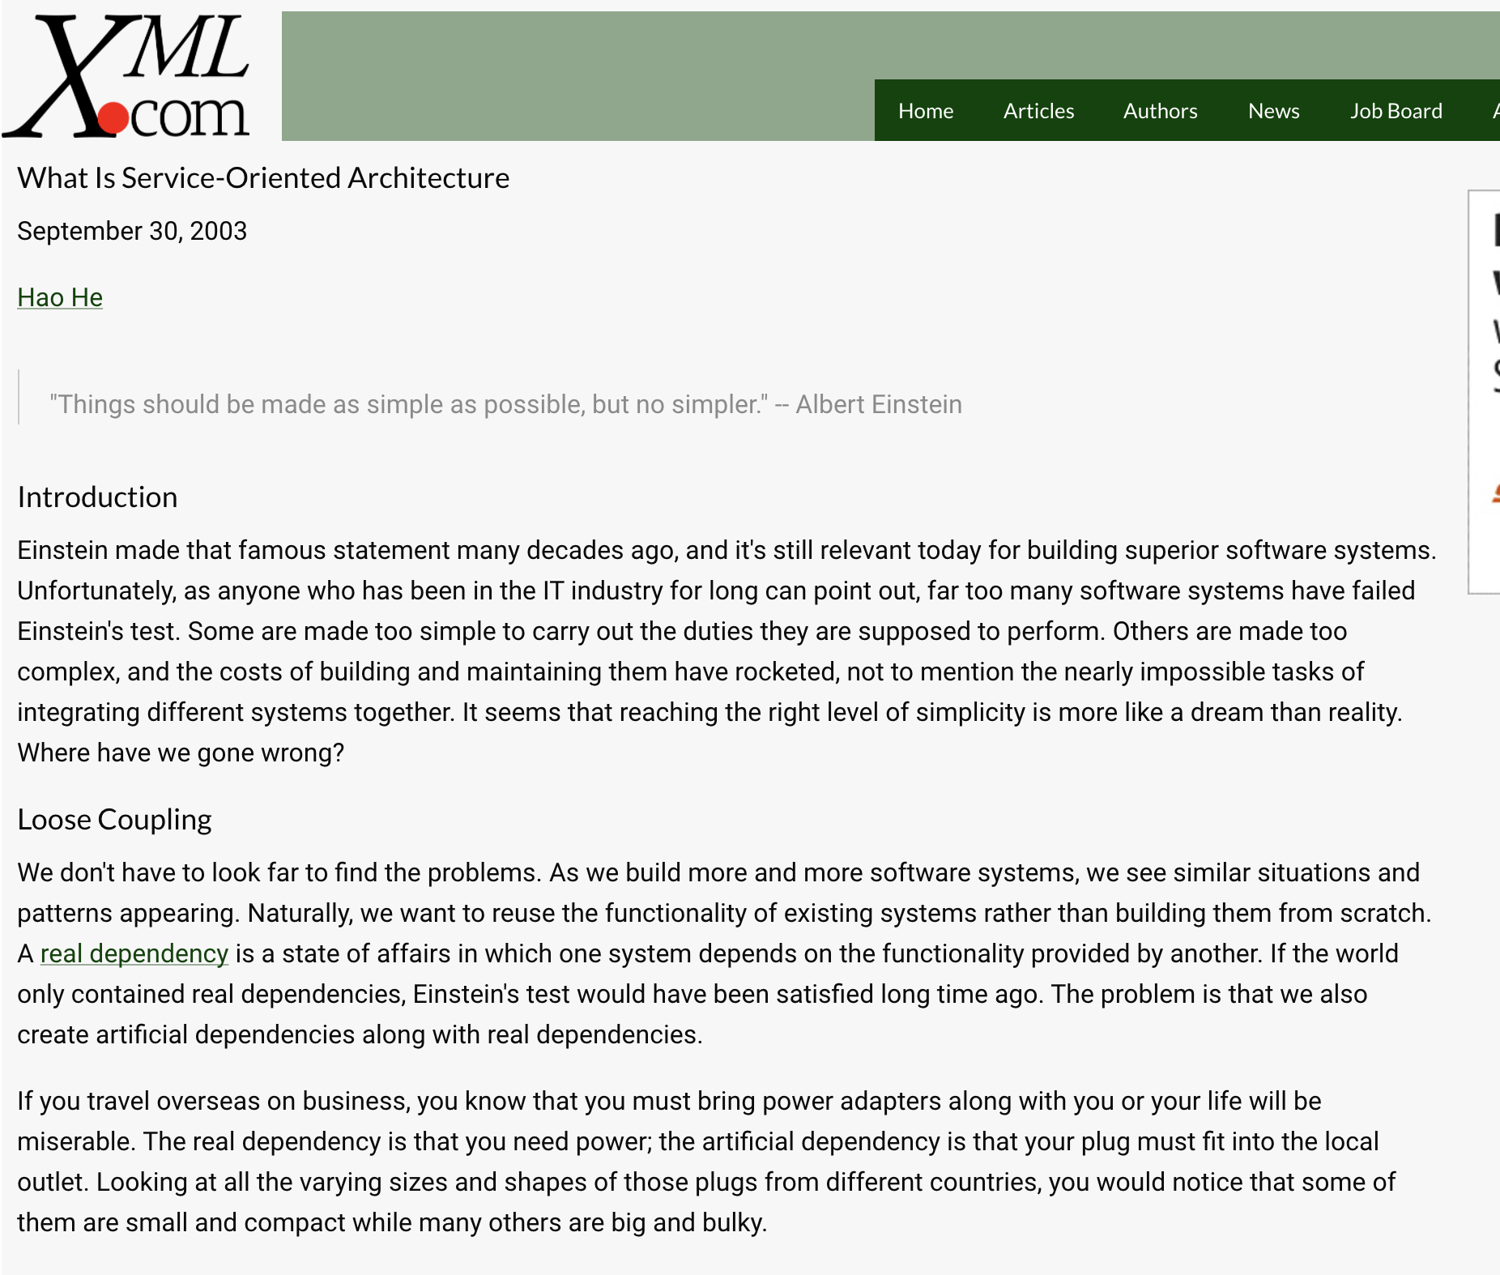
What is SOA?
http://www.xml.com/pub/a/ws/2003/09/30/soa.html

Slide 4
SOA Explained
An architectural style to achieve loose coupling whose fundamental building blocks are services, which are modelled directly on business services.
Two important architectural constraints:
A small set of simple and ubiquitous interfaces to all participating software agents. Only generic semantics are encoded at the interfaces. The interfaces should be universally available for all providers and consumers.
Descriptive messages constrained by an extensible schema delivered through the interfaces. No, or only minimal, system behavior is prescribed by messages. A schema limits the vocabulary and structure of messages. An extensible schema allows new versions of services to be introduced without breaking existing services.

Slide 5
Common SOA technologies: SOAP Web Services
Standards developed by W3C and other standard bodies
Although it satisfies SOA definition but the technologies are overly complicated and interoperability is poor
The overhead introduced by SOAP is significant and system performance is very low
Both development cost and running cost are very high

Slide 6
Common SOA technologies: RESTful Web Services
Interfaces are limited to HTTP. The following semantics are defined:
HTTP GET is used for obtaining a representation of a resource. A consumer uses it to retrieve a representation from a URI. Services provided through this interface must not incur any obligation from consumers.
HTTP DELETE is used for removing representations of a resource.
HTTP POST is used for updating or creating the representations of a resource.
HTTP PUT is used for creating representations of a resource.
Most messages are in JSON

Slide 7
Conventional Application Architecture
Presentation Layer
API calls or RPC
Business Logic Layer
API calls or RPC
DB
Layer

Slide 8
Conventional Web Application Architecture
Browser
Dumb client
HTTP
Presentation Layer
Page
Render
API calls or RPC
Business Logic Layer
API calls or RPC
DB
Layer

Slide 9
SOA Application Architecture
Presentation Layer
Service Calls
Business Service
Business Service
Storage
Service
Storage
Service
Storage
Service

Slide 10
SOA Web Application Architecture
Browser: Rich Client
AJAX Calls: JSON over HTTP
Business Service
Business Service
Storage
Service
Storage
Service
Storage
Service

Slide 11
SOA Web Application
UI is strictly implemented in the Browser layer using HTML5/JavaScript technology stack
All communication to services are JSON over HTTP and/or WebSocket
No rendering of UI on the server side is allowed!
This point is very important

Slide 12
Micro Services vs SOA
Micro Services are SOA
It introduces additional architectural constraints on SOA:
A service must be sufficiently small to be maintained by a small team
A service should be self-contained
“Micro” is relative. Someone’s small might be others’ big.
Micro Services are defined along business organisations

Slide 13
Monolithic Architecture vs Micro Services
An “all-in-one” application
Internal building blocks are components and inter-component communications are through API calls
Updating a component requires updating the whole application
Monolithic Architecture can be used to implement conventional architecture and SOA
Benefits
Simple to develop, test and deploy
Simple to scale

Slide 14
Monolithic SOA
Browser: Rich Client
AJAX Calls: JSON over HTTP
Service Interface
API calls
API calls
API calls
DB
Module
Module
System boundary

Slide 15
Micro Services
Browser: Rich Client
AJAX Calls: JSON over HTTP
Service Interface
Service Interface
Business Logic
Business Logic
DB
DB
System boundary
Service
Service

Slide 16
Micro Services
Each service is a small application
Each service contains its own business logic and DB
Inter service communications are strictly through service calls
Benefits
Each service is developed, tested and deployed independently
Each service can be scaled independently
Allow good mixture of technologies as each service can be implemented with its own technologies
Continuous deployment is easy

Slide 17
Monolithic SOA vs Micro Services: disadvantages
Monolithic SOA | Micro Services
As the complexity increases, the system becomes too hard to maintain. Small changes can have huge impacts. | Inherently distributed system: data integrity problem. Network reliability and latency often ignored and cause problems later.
Single technology | Managing a large number of services is challenging.
Can easily become bloated | Difficult to test and debug an application that depends on many other services.

Slide 18
Event Driven Micro Services
Browser: Rich Client
AJAX Calls: JSON over HTTP
Service Interface
Service Interface
Business Logic
Business Logic
WebSocket
DB
DB
WebSocket/async service call
Event Bus

Slide 19
XPE Event Driven Micro Services
Browser: Rich Client
AJAX Calls: JSON over HTTP
XPE Web Server and Smart Service Proxy
SOAP to JSON
Business Logic
Business Logic
SOAP
WS
WebSocket
XPE DB
XPE DB
Thirdparty
Services
Micro Container
Micro Container
Event Bus: XPE Messaging Server

Slide 20
XPE Event Driven Micro Service Architecture
Use the latest and best known algorithms and completely rewrote low-level libraries to replace standard Java libraries
High performance and reliability
High system security
World’s fastest Web Server (7 x Apache, and 2 x Nginx)
Smart service proxy for easy integration with micro services
Micro containers for easy deployment and management
A service packed with a container can be as small as a few kbs
Event messaging server for data integrity
All events are log based
Service are deterministic
Easy debugging by replaying event logs

Slide 21
XPE Technology Stack
Celer Cloud IDE
Applications
Applications
XPE Cloud IDE
Applications
eCommerce
Wechat
GMS
IDE
SOAP
Mail
GIT
XPE Messaging Server
XPE Web Server/Smart Proxy
XPE Service Registry
XPE DB
XPE High Performance Java Core Library

Slide 22
XPE High-Performance Java Core Library
Rewrite of low-level Java core library
Take advantage of latest advancement in
Cache oblivious algorithms
Advanced hashing algorithms
Non-blocking concurrent algorithms
Highly efficient binary protocols
and many many more
Results
Minimum 10 times memory efficient than standard Java implementations
Up to several hundred times faster than standard Java implementations
Both performance and memory usage approach theoretical limits

Slide 23
XPE DB
New generation NOSQL DB based on event log architecture
Ensures data integrity
High performance: up to 1 million queries and writes per second.
Simple and extensible data structure using JSON
Support full-text search, ordered server, wildcard search etc

Slide 24
Common SQL DB Architecture
Connection Pool
SQL Parser
SQL Optimiser
Cache
Storage
Engine

Slide 25
XPE DB Architecture
Query
Write
Access Control
Query Engine
In-memory indices
Index builder
Append Only Event Log

Slide 26
Key Differences between XPE DB and SQL DB
 | SQL DB | XPE DB
IO and storage | Special designed file layout. Random reads and writes. Performs drops as more data is stored. Typical performance is less than 1000 rw/s. | Sequential writes only. Maximum performance possible and no degrading as more data is stored. Up to 1 M rw/s.
Query | SQL needs to be parsed and optimised. Areas for bad security concerns (SQL-injection) | Simple key-value query for high performance.
Indices | Mostly B+ tree. Requires plug-ins for full-text index. | A large collection in-memory based indices that support full-text, wildcard, inverted word searching
Running | Run as a server through network connections. Added overhead on the same host. Hard to use for micro service. | Use as a library or service. Zero overhead for micro-service.
Scaling | Hard to scale. Data integrity is difficult to maintain in a distributed environment. | Simple to replicate. Just duplicate the event log.

Slide 27
Integration with SQL DB: Sync Service
DB Reader sends a new HTTP request to the SQL Sync Service whenever a new data entry/modification/deletion Event has occurred
Need custom development on DB Reader
Allows very flexible and selective data sync
Supports Oracle, MySQL, DB2 and SQL Server
SQL Sync
Service
DB
Reader
HTTP
XPE
DB
SQL
DB

Slide 28
Integration with SQL DB: Sync DB Log
Log reader reads the log file produced by a SQL DB and converts each log entry to an MS event, and feeds events to MS
No custom development required
It reads all data
Supports Oracle, MySQL, DB2 and SQL Server
XPE
DB
SQL
DB
MS
Log Reader

Slide 29
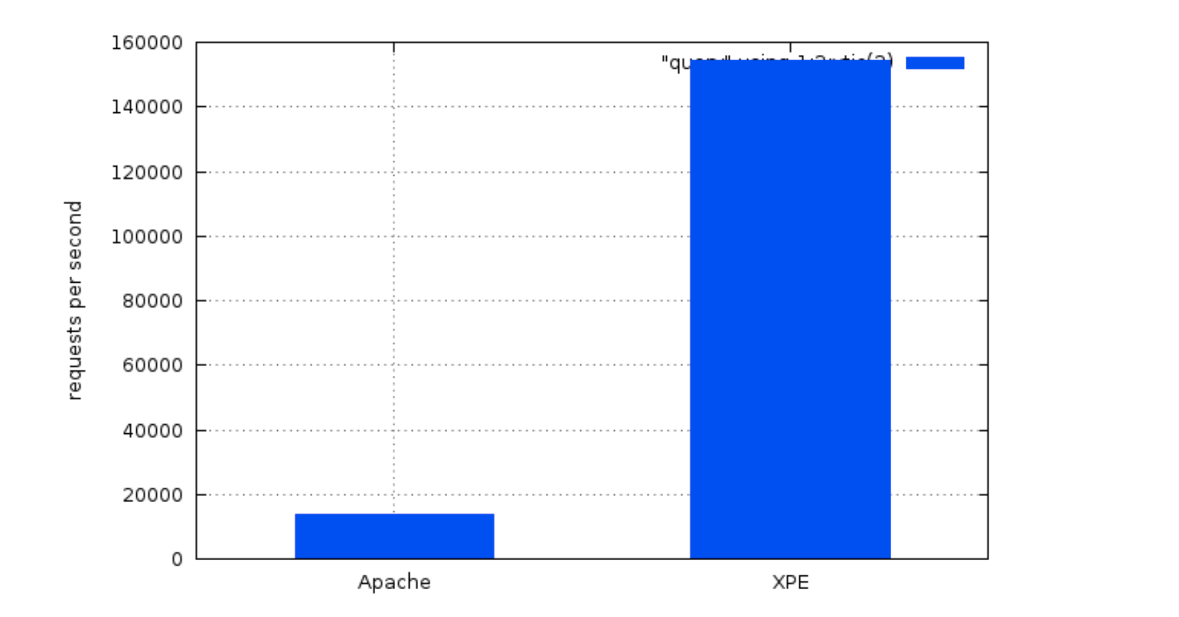
Real-world application benchmark results
Apache+PHP+MySQL vs XPE: real application benchmark

Slide 30
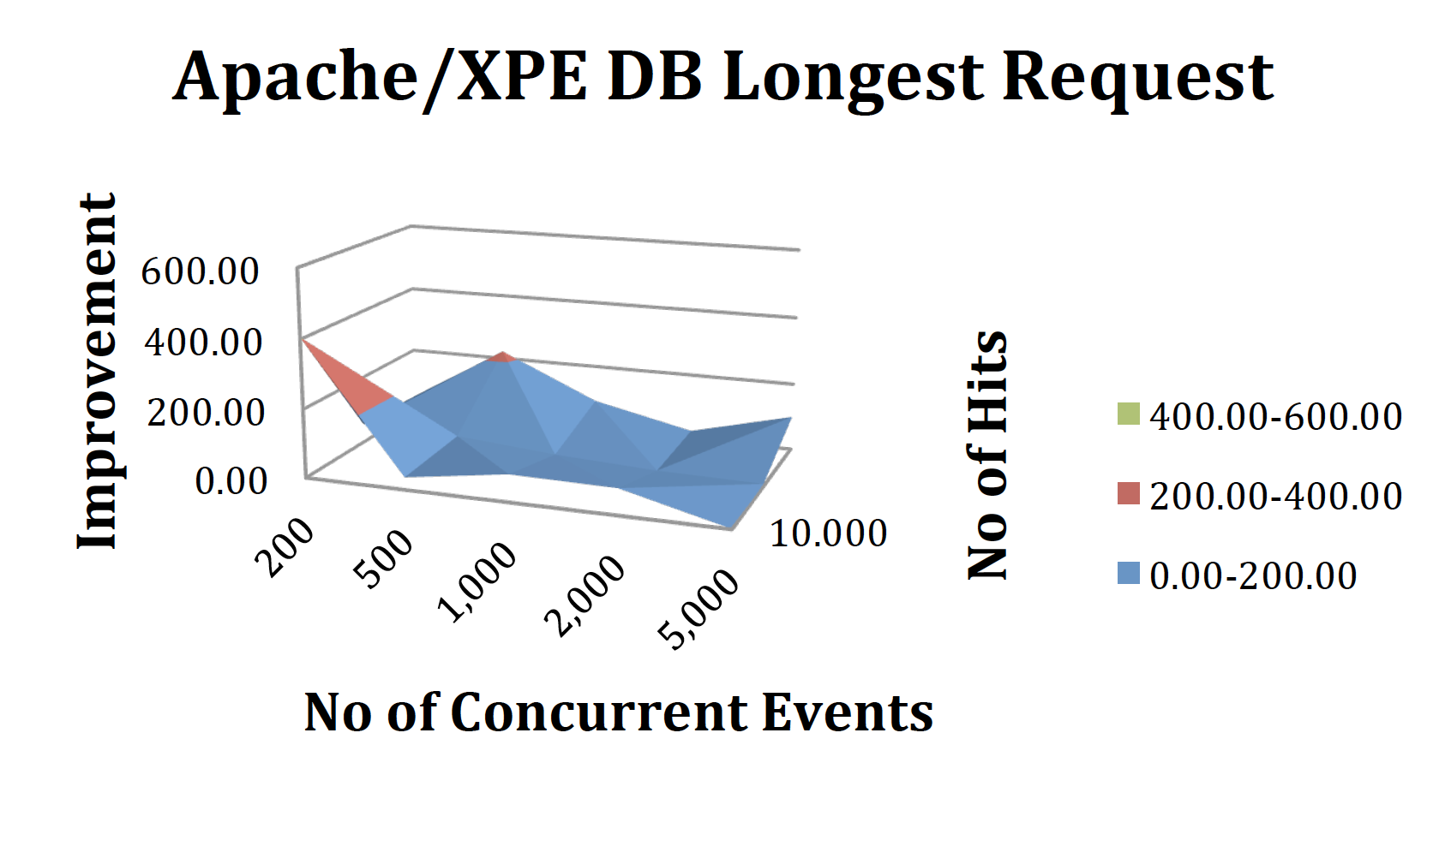
XPE improvements over LAMP
Great improvement for longest requests

Slide 31
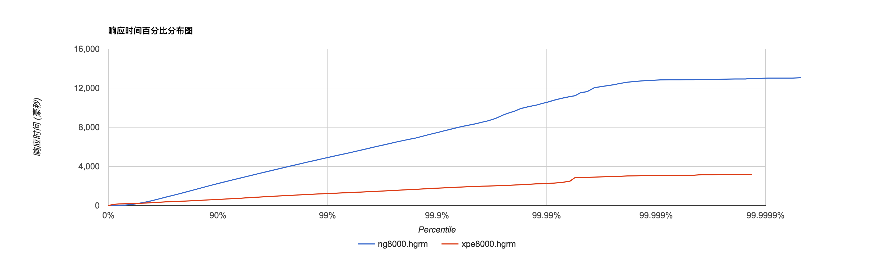
XPE WebServer vs Nginx
100,000 reqs per second
8000 concurrent connections
X-axis is percentile, Y-axis is response time in ms. The lower the better
Nginx is significantly slower than XPE

Slide 32
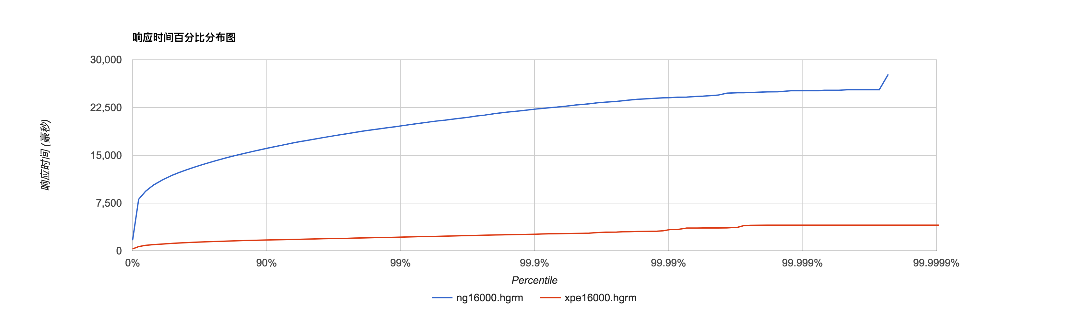
XPE WebServer vs Nginx
100,000 reqs per second
16000 concurrent connections
X-axis is percentile, Y-axis is response time in ms. The lower the better
Nginx is now too slow to use while XPE is still highly responsive

Slide 33
XPE Messaging Server
JS App
JS App
SQL
DB
JS, Java, R App
Other App
Smart
Devices
Lang Adapter
Container Adapter
IOT Adapter
DB Adapter
Machine Learning
Recommender
XPE Messaging Server
XPE Service Registry
XPE Web Server/Smart Porxy

Slide 34
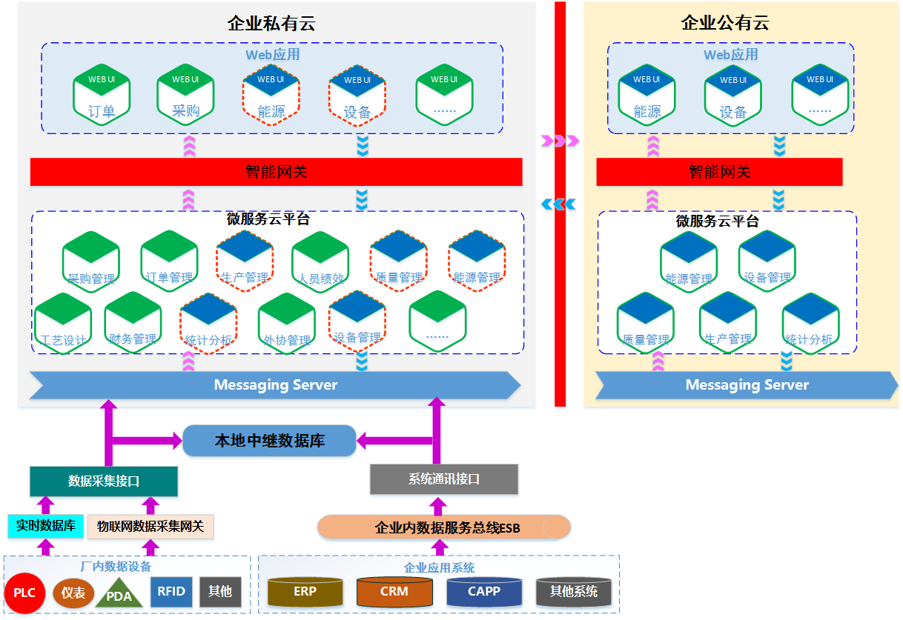
Case Study: Smart Factory

Slide 35

Case study: www.cqooc.com
One of the largest online learning platforms
Serving 1M+ students and students in ChongQing

Slide 36
Simplified Application Architecture: www.cqooc.com
Browser: Rich Client
AJAX Calls: JSON over HTTP
XPE Web Server and Smart Service Proxy
Exam
Service
Mooc
Service
Evaluating
Service
Recommending
Service
Media Processing
Service
XPE Messaging Server

